Slide 1
Unsupervised Learning Part 2
UIUC ECON 490 Applied Machine Learning in Economics

Slide 2
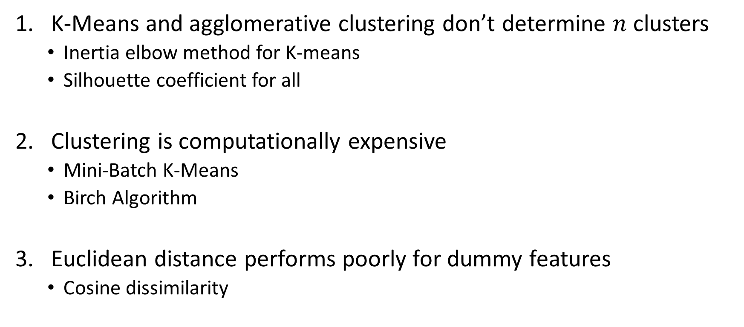
Guidance for unguided learning when clustering
K-Means and agglomerative clustering don’t determine $n$ clusters
Inertia elbow method for K-means
Silhouette coefficient for all
Clustering is computationally expensive
Mini-Batch K-Means
Birch Algorithm
Euclidean distance performs poorly for dummy features
Cosine dissimilarity

Slide 3
How many clusters?
Using metrics from the clusters

Slide 4
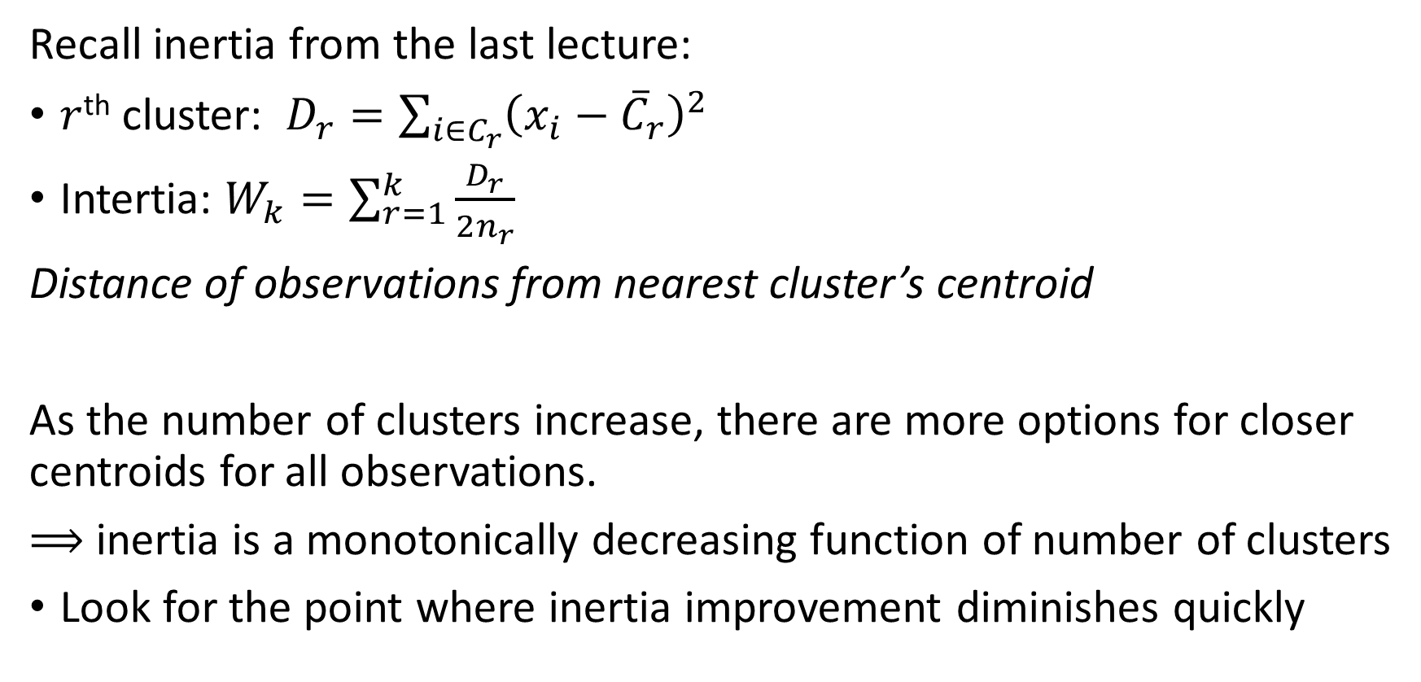
Find inflection point (elbow) for K-means inertia
Recall inertia from the last lecture:
$r$^{th} cluster: $D_{r}=\sum_{i∈C_{r}}{{\left(x_{i}−{\overline{C}}_{r}\right)}^{2}}$
Intertia: $W_{k}=\sum_{r=1}^{k}{\frac{D_{r}}{2n_{r}}}$
Distance of observations from nearest cluster’s centroid
As the number of clusters increase, there are more options for closer centroids for all observations.
$⟹$ inertia is a monotonically decreasing function of number of clusters
Look for the point where inertia improvement diminishes quickly

Slide 5
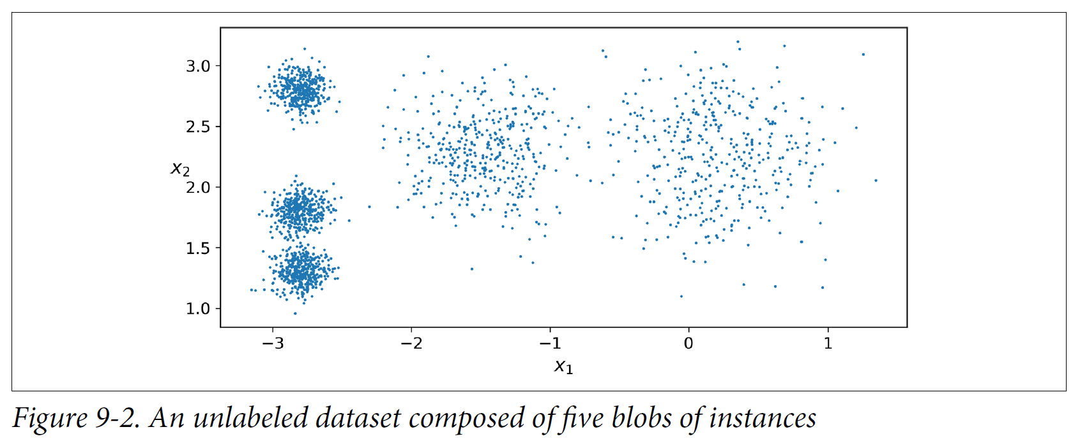
Elbow method on these simulated data

Slide 6
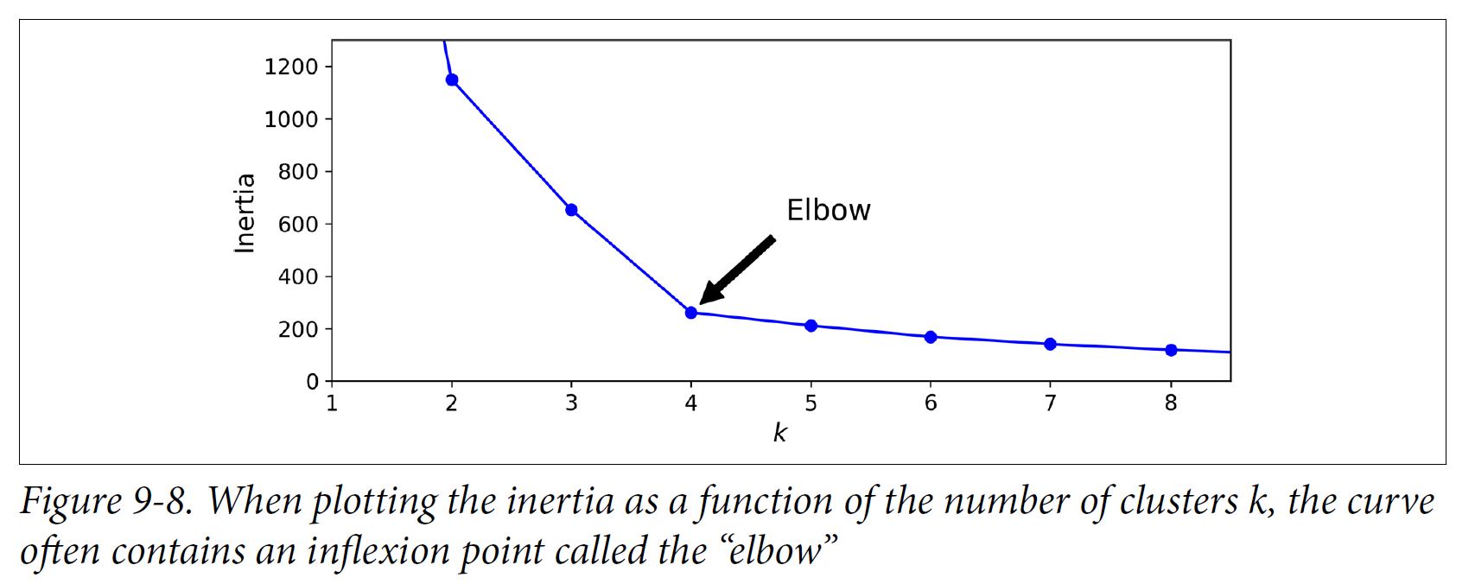
Sometimes elbow method is nice to us

Slide 7
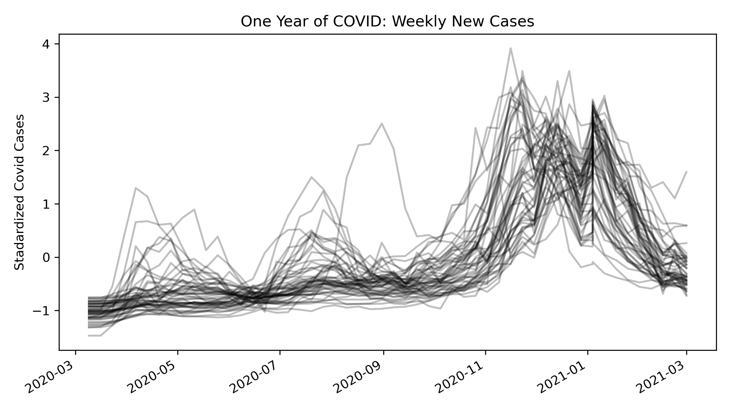
Elbow method on our state COVID data

Slide 8
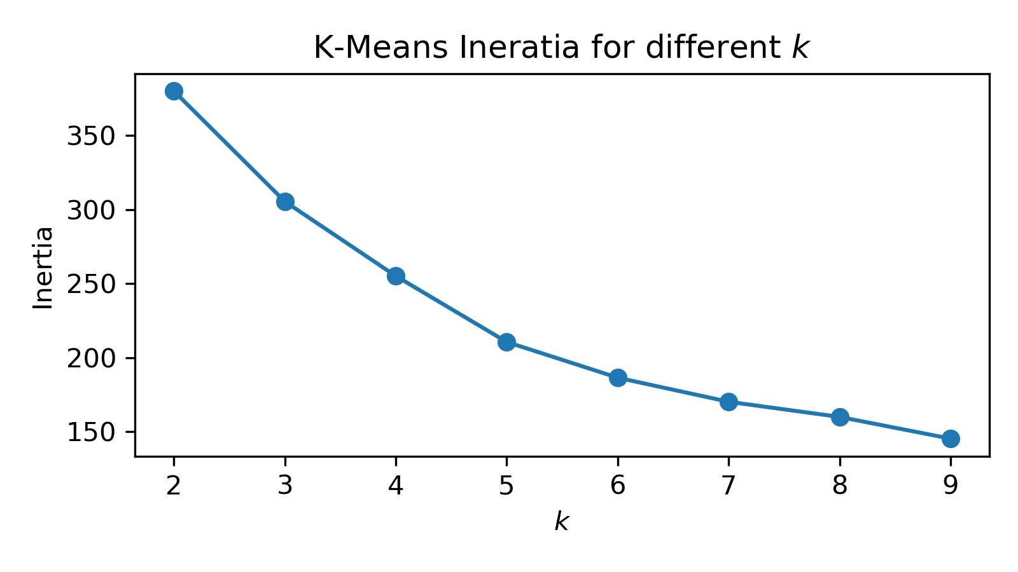
But sometimes not

Slide 9
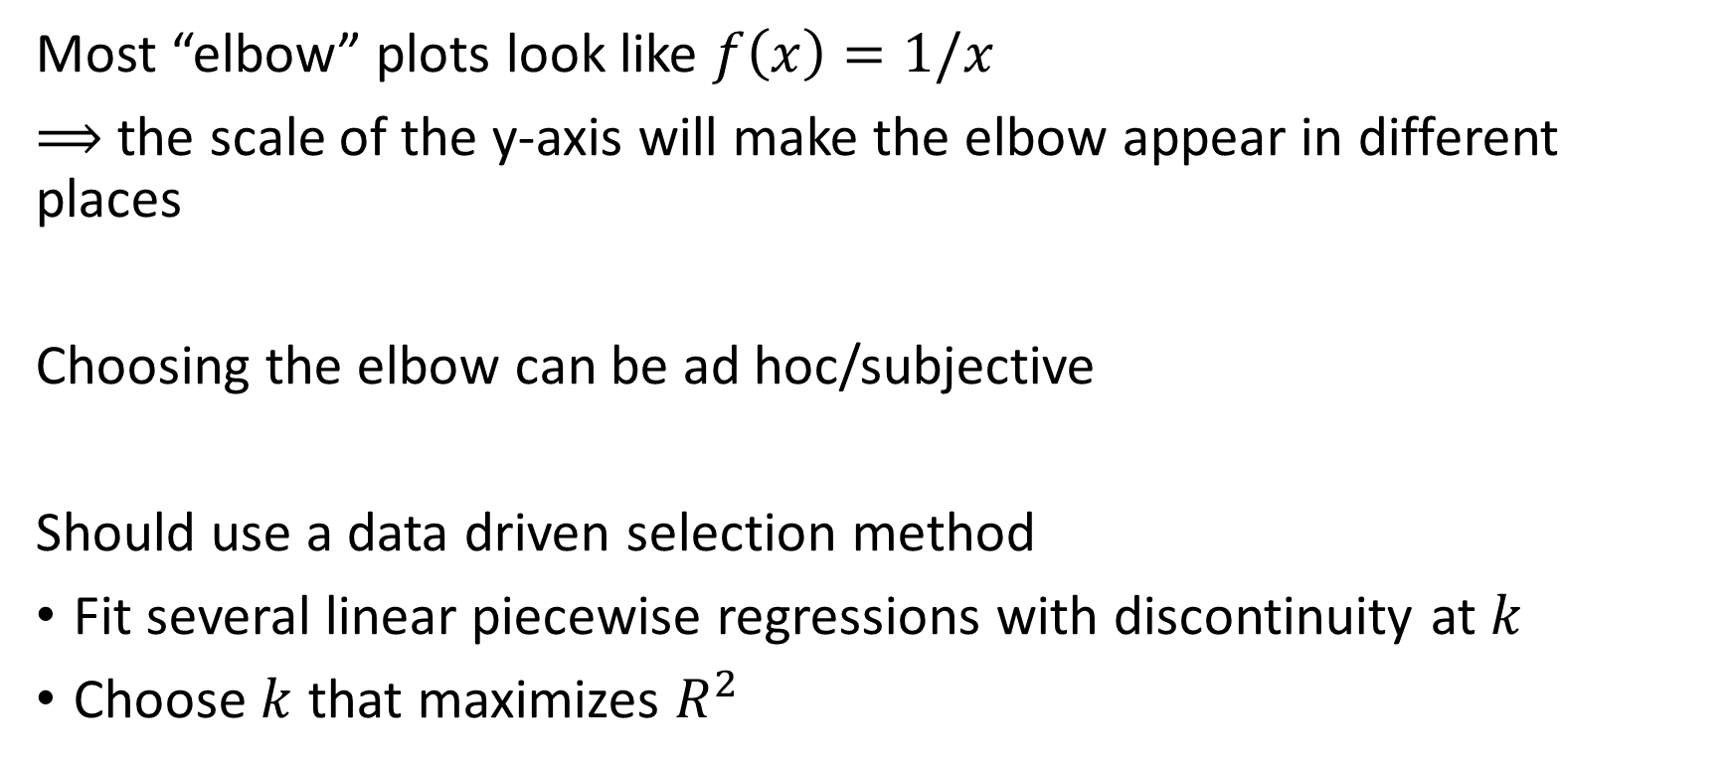
My criticisms of the elbow method
Most “elbow” plots look like $f\left(x\right)=1/x$
$⟹$ the scale of the y-axis will make the elbow appear in different places
Choosing the elbow can be ad hoc/subjective
Should use a data driven selection method
Fit several linear piecewise regressions with discontinuity at $k$
Choose $k$ that maximizes $R^{2}$

Slide 10

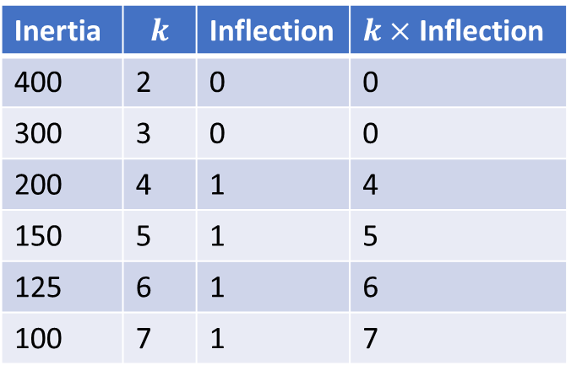
DataFrame setup for sklearn
Inertia | $$k$$ | Inflection | $k×$ Inflection
400 | 2 | 0 | 0
300 | 3 | 0 | 0
200 | 4 | 1 | 4
150 | 5 | 1 | 5
125 | 6 | 1 | 6
100 | 7 | 1 | 7
$$y=\left\{\begin{matrix}β_{0}+β_{1}x & if x<k \\ \left(β_{0}+β_{2}\right)+\left(β_{1}+β_{3}\right)x & ifx≥k\end{matrix}\right.$$

Slide 11
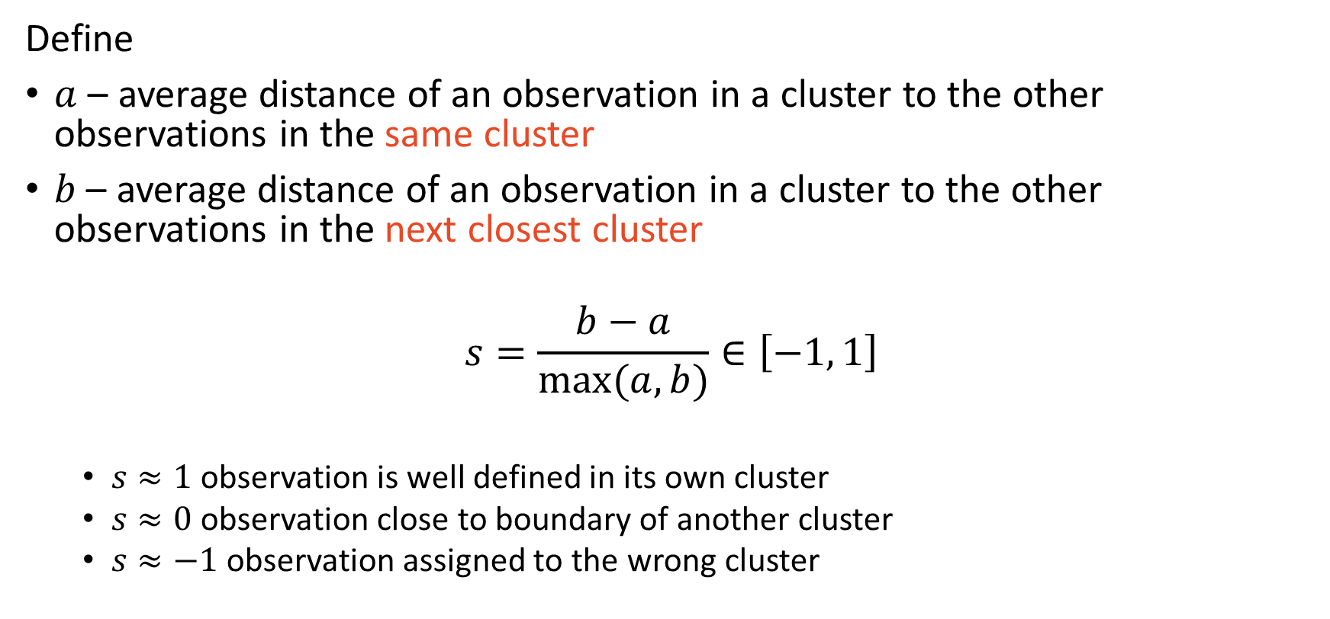
Silhouette coefficient is a better indicator
Define
$a$ – average distance of an observation in a cluster to the other observations in the same cluster
$b$ – average distance of an observation in a cluster to the other observations in the next closest cluster
$$s=\frac{b−a}{max(a, b)}∈\left[−1, 1\right]$$
$s≈1$ observation is well defined in its own cluster
$s≈0$ observation close to boundary of another cluster
$s≈−1$ observation assigned to the wrong cluster

Slide 12
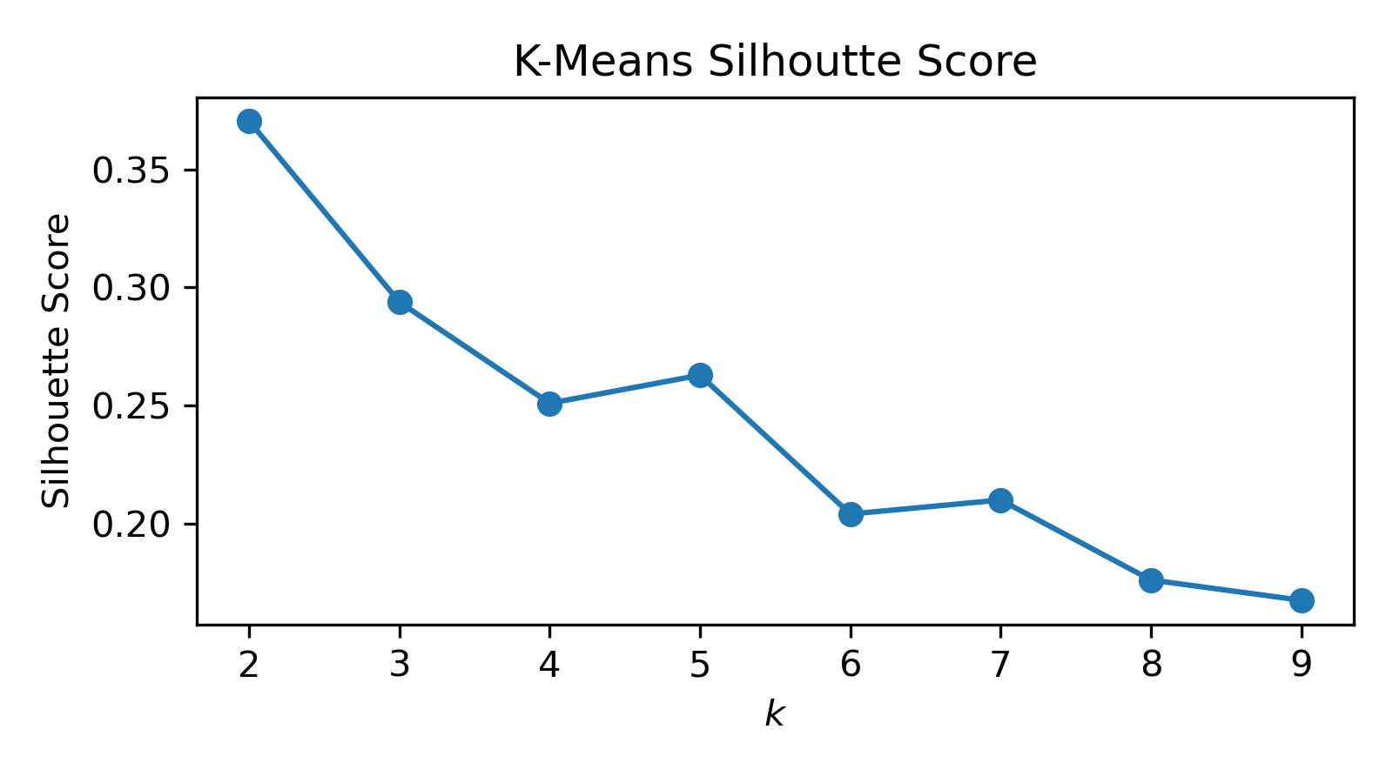
Silhouette score for state COVID data

Slide 13
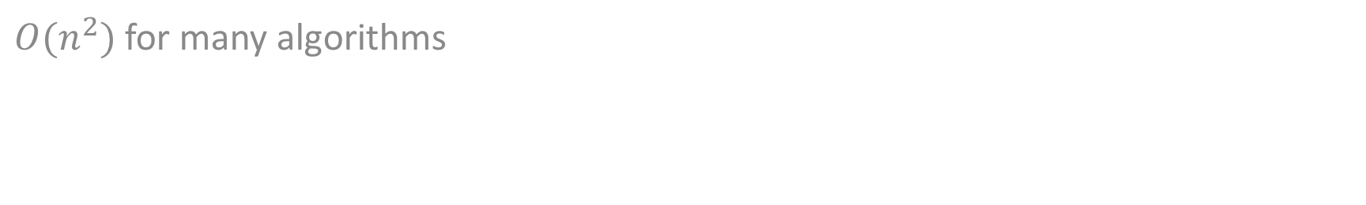
Clustering is expensive
$O(n^{2})$ for many algorithms

Slide 14
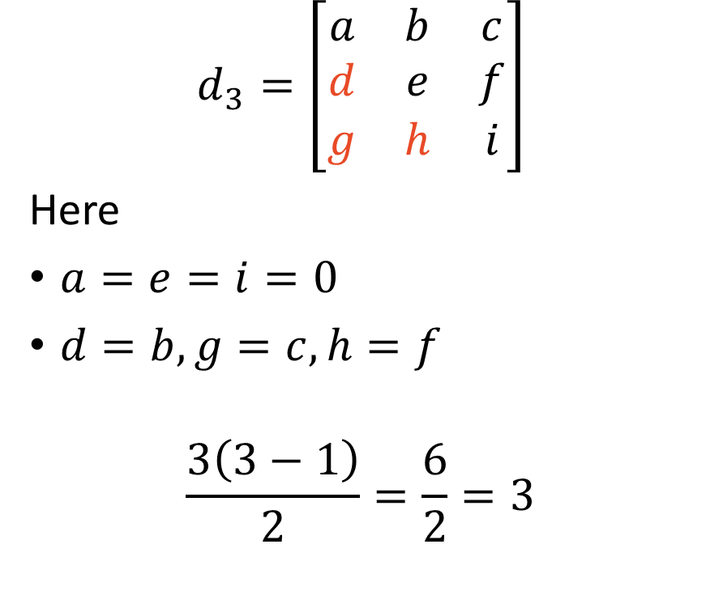
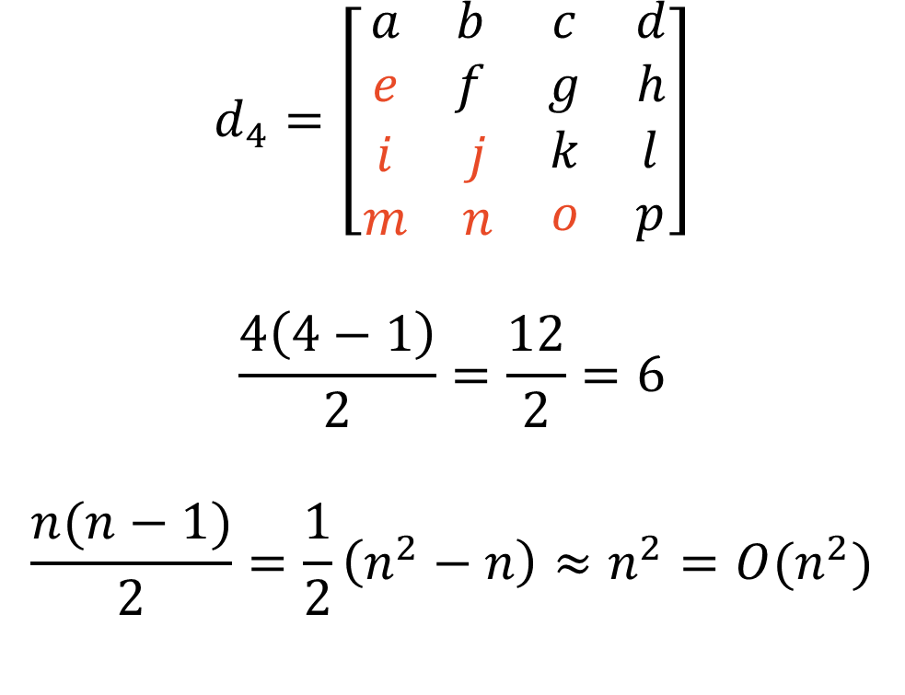
Clustering requires distance matrices: $\frac{n(n−1)}{2}$
$$d_{3}=\left[\begin{matrix}a & b & c \\ d & e & f \\ g & h & i\end{matrix}\right]$$
Here
$a=e=i=0$
$d=b,g=c,h=f$
$$\frac{3\left(3−1\right)}{2}=\frac{6}{2}=3$$
$$d_{4}=\left[\begin{matrix}\begin{matrix}a & b \\ e & f\end{matrix} & \begin{matrix}c & d \\ g & h\end{matrix} \\ \begin{matrix}i & j \\ m & n\end{matrix} & \begin{matrix}k & l \\ o & p\end{matrix}\end{matrix}\right]$$
$$\frac{4\left(4−1\right)}{2}=\frac{12}{2}=6$$
$$\frac{n(n−1)}{2}=\frac{1}{2}\left(n^{2}−n\right)≈n^{2}=O(n^{2})$$

Slide 15
Using mini-batches is an easy workaround
Mini-batch K-Means
Think mini-batch gradient descent for NN, but K-Means
Doesn’t converge, but has stopping criteria
Inertia improvement
Uses:
Stand-alone
Data aggregator
produce 100+ clusters & obtain centroids (average of each feature in cluster)
Treat new clusters as data to feed into alterative algorithm

Slide 16
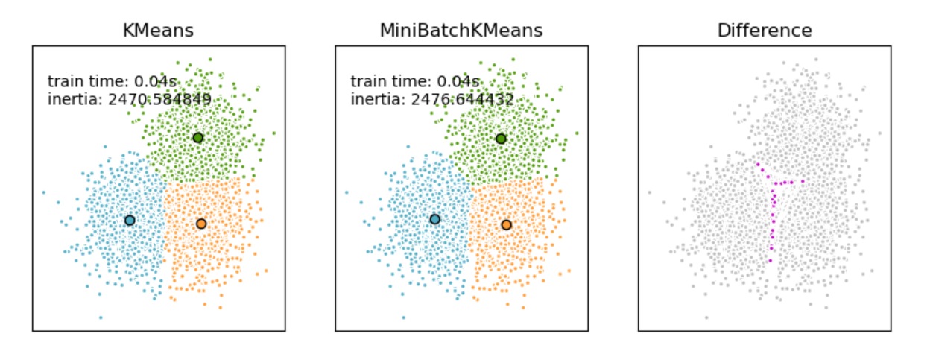

Slide 17
Euclidean distance for binary data
Categorical data, text, etc.

Slide 18
Euclidean distance fails at binary data
Euclidean is good for continuous features, but not binary
Suppose online shopping
Ben buys a computer
Jen buys a sneaker
Sven buys a sneaker, a boot, socks, and flip flops
Euclidean says Ben is closer to Jen, but in reality, Jen is closer to Sven
Think about dummy vector over goods purchased

Slide 19
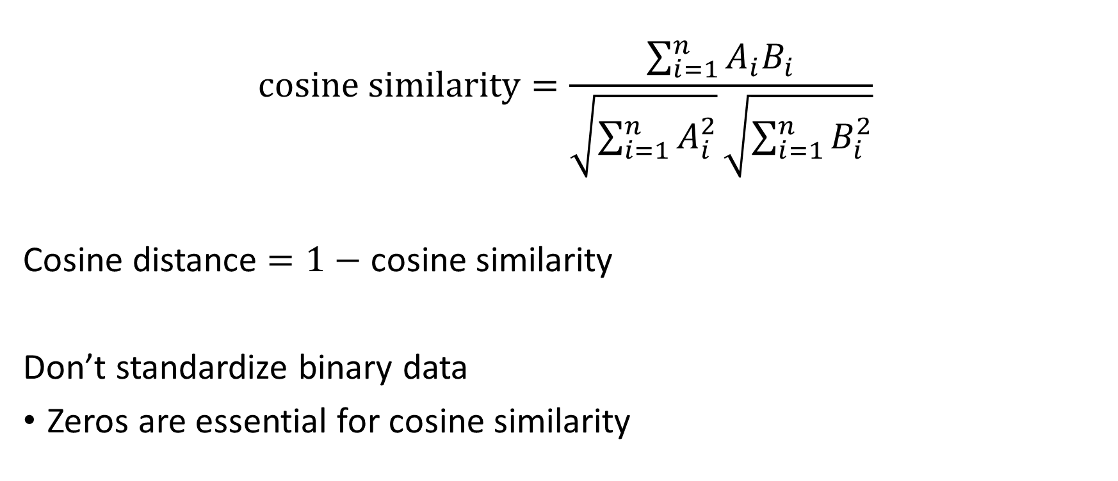
Use cosine distance for binary data
$$cosine similarity=\frac{\sum_{i=1}^{n}{A_{i}B_{i}}}{\sqrt{\sum_{i=1}^{n}{A_{i}^{2}}}\sqrt{\sum_{i=1}^{n}{B_{i}^{2}}}}$$
Cosine distance $=1−$ cosine similarity
Don’t standardize binary data
Zeros are essential for cosine similarity

